Slide 1
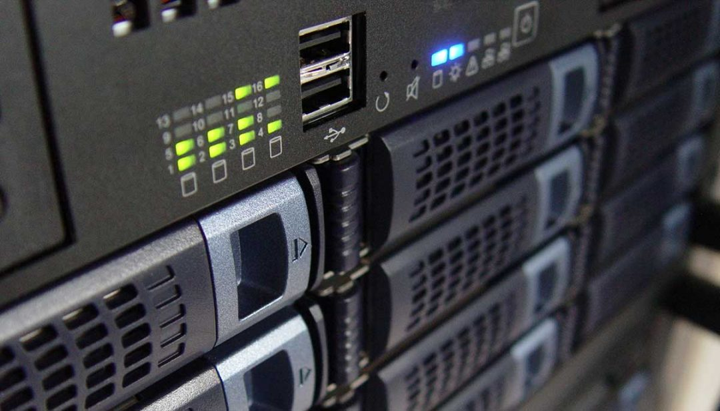
Problem statement
Design a load balancer for the electrical appliances in your home that would allow the input voltage of 240 volts to be optimally utilized by various appliances ranging from a tube/LED lights (consume less power)to water pumps or air conditioners(consume much of the total power). The load balancer should be in position to tackle the situation wherein there is a real demand for input power for a certain device but there are other devices which simply over utilize the power.

Slide 2
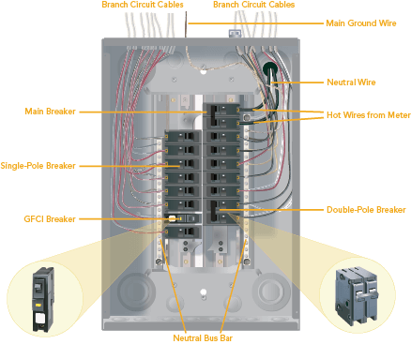
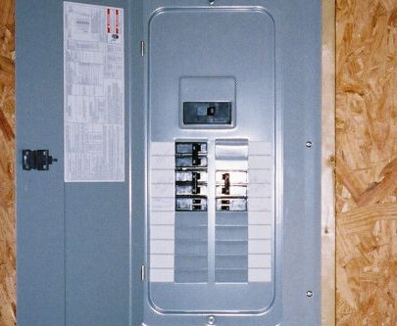
Electrical Basics to understand this problem
Most homes have a type of electrical service called single phase, three-wire. The service comes from the utility via two ungrounded ("hot") wires that carry 120 volts each, plus a single grounded ("neutral") wire. The wires connect to the home's service panel, and each hot wire provides 120-volt power to one of the two hot bus bars in the panel. The circuit breakers for the various household circuits (called branch circuits) snap into the panel and connect electrically to one or both of the hot bus bars.​
Like the utility service wires, each branch circuit has one or two hot wires and a neutral wire. The electrical power leaves the panel along the hot wires and returns to the panel on the neutral. From there, the power goes back onto the utility grid via the utility service neutral.​
This panel consists of parts such as:
1.Main breaker
2.Switch breakers
3.Double and single pole breakers
4. 2Neutral bus bars
SERVICE PANEL

Slide 3
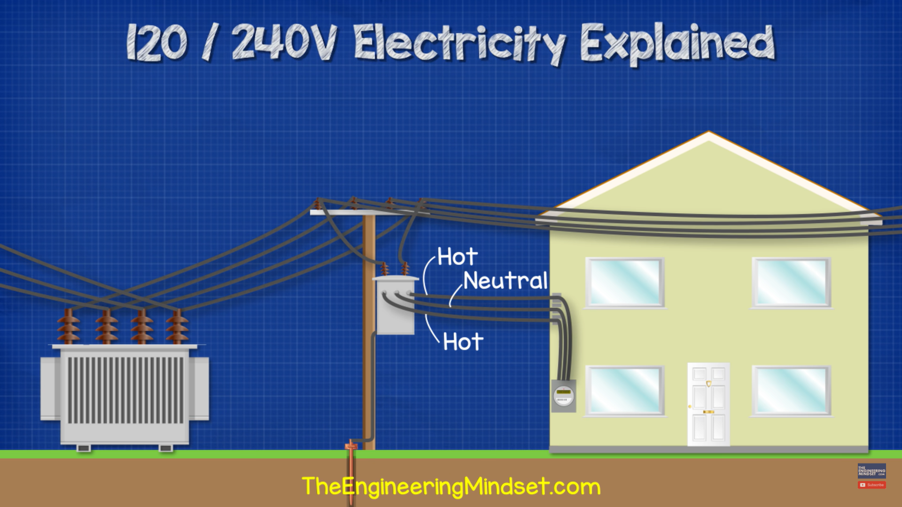
How electricity Reaches our home

Slide 4
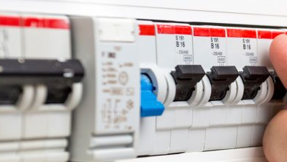
SWITCH BREAKERS
This is the primary component of the electric panel. Each appliance is connected to separate switch breakers through main circuit of each rooms. The circuit is connected to breakers according to amperage requirements.
Whenever a appliance use more power than the breaker is specified like 5-10A or 15-20A,20-30A the switch trips automatically if it exceeds the limit.
Single pole breakers which give 120V from one of the hot bus, these switches can be used for low voltage appliances
Double pole breakers in which 2 hotbus wires gets connected and collectively gives 240V which can be given to high voltage appliances.
GFCI breakers are special breakers which can be used in kitchen, restrooms, etc to control voltage rise when hotbus wires touch each other, it trips .
AFCI breakers are special breakers for bedrooms, hall, etc because when some metal screws touch both wires a specific signal arises and to reduce voltage rise, it trips .

Slide 5
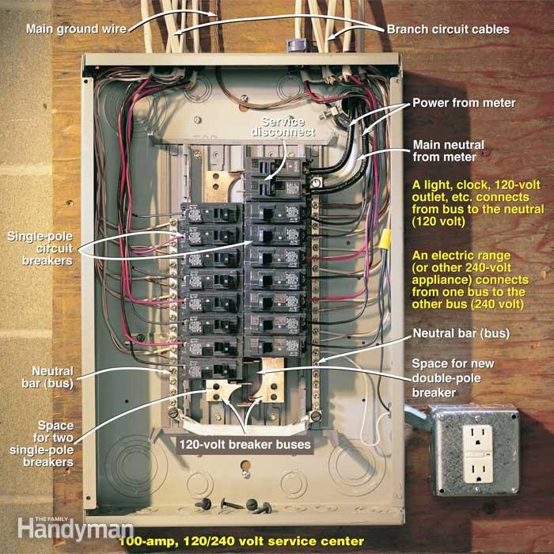
OUR UNDERSTANDING OF THE PROBLEM
There is already a technique in which load is balanced in households.
The existing solution is completely hardware based and no computer is needed as most of the problems are resolved by the service panel.
The load balancer which we are designing should make sure that power is distributed to appliances in such a way that the current returned to neutral wire in service panel is as low as possible.
Adding and removing appliances of different power levels possess a risk as wiring and connection cannot be done again by renovating the house.
A specific part in the problem that cannot be resolved by the existing solution is to tackle the situation wherein there is a real demand for input power for a certain device but there are other devices which simply over utilize the power.
Here in this situation when power is overutilized and a appliance is in short of power the switch of overutilizing appliance just trips down and optimizes the power.
There is a situation where some people without basic electrical knowledge would not know to turn the breaker switch on.
So to tackle this situation which is the only situation we found the disadvantage for this panel so we made a solution using computers and IoT tech and the pattern recognized in panels and server load balancers.

Slide 6


DESIGNING THE SOLUTION

Slide 7

How to solve this Problem
Pattern identification
Abstraction
Pattern recognition
Decomposition

Slide 8

Pattern Identification
Can it be solved by a computer?
Yes, load balancing can be done using programs as there is a general technique/algorithm to solve the problem
A lot of physics and hardware knowledge is required to design the device.
The device we are designing should be heat resistant. Device cannot afford to breakdown if there is a short circuit or due to other factor . The device should be made by insulators for safety reasons. We have to design a entirely new power grid if needed or to make changes in the already existing grid.

Slide 9
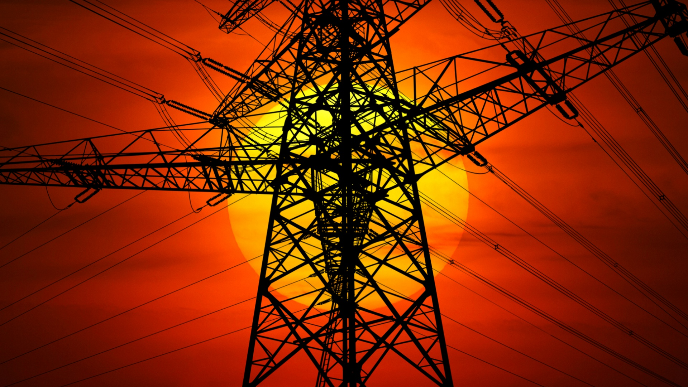
Decomposition of the problem
Where is it used?
Home/Industrial place.
What are appliances in home?
Refrigirator,AC,UPS,TV,Chimney,geaser,Waterpumps,mixer,grinder,microwavekitchen appliances,[high power load]
Lights ,fans, power sockets for chargers, iron box, etc[low power loads]
Computer[power change according to usage]
Find the current drawn for each appliances?
How is a load balancer built?
What are its components?
How is load been separated done before?
How to use a fuse here?
Where should we place the electric panel?
In which country we are using it as voltage changes and each country has separate electrical codes?
Also placement of breakers differ so where should we place switch breakers?
Which appliances need double pole and single pole breakers?
Which rooms require GFCI and AFCI breakers?

Slide 10
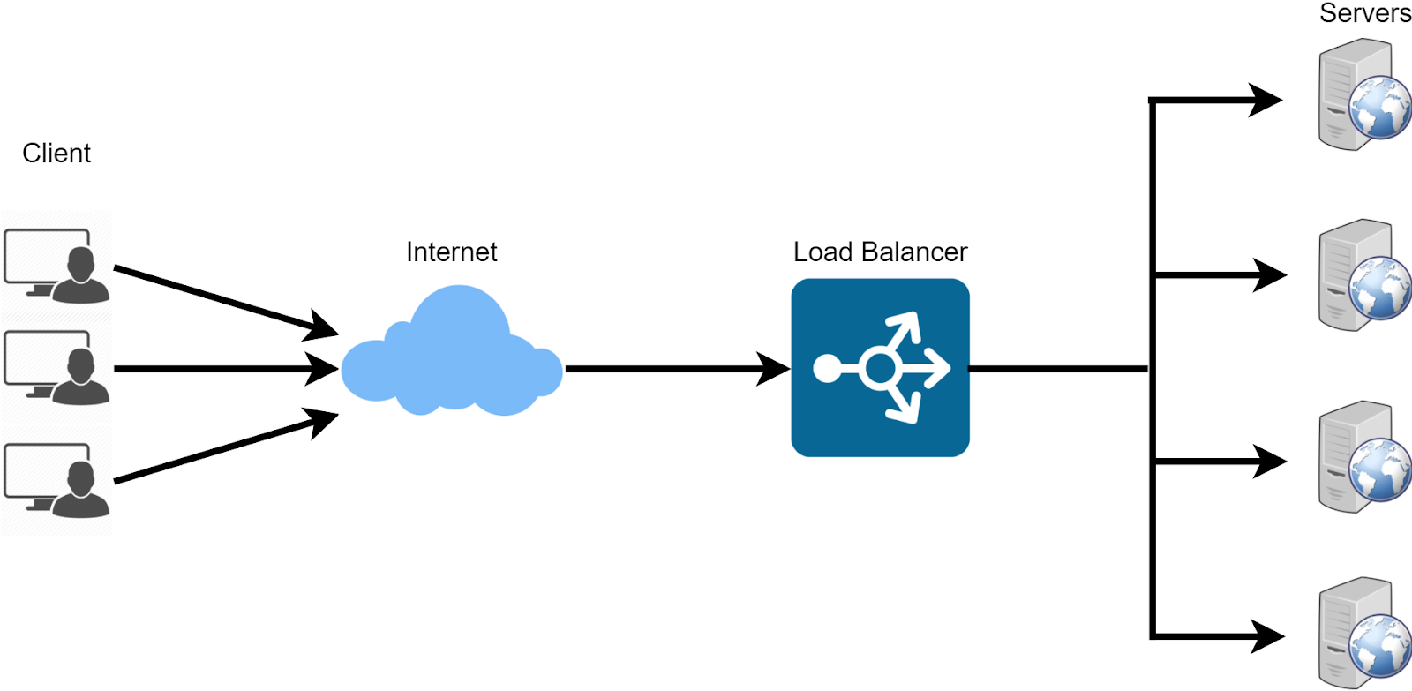
Pattern Recognition[Server Load Balancing]
The given problem is completely hardware oriented, we also found a similar problem load balancing in servers.
Server load balancer reduces traffic between client and servers by efficiently distributing the request from client to servers.
Reliability and availability to only servers which are available and then adding and removing servers with ease
The algorithms it follows are:
1.Round robin
2.Least connection
3.Ip Hashing technique

Slide 11
SIMILARITY FROM SERVER LOAD BALANCING
We can assume the servers as home appliances, load balancer as the electrical panel and client request as current which needs to distributed.
Programs can be created to distribute current to make sure that current returned on neutral is as low as possible.
We can use IP hash technique to connect appliances to the load balancer so it can monitor the power drawn and in case if it over utilises the power the balancer can optimise it.

Slide 12

A Solution idea
We can use the same electrical panel used in our homes. Like service meter where total electricity usage of our home is measured, we can add meters to every circuit to monitor the power usage.
We can add a display with a user interface where we are able to see the power drawn by every appliances in the circuit in real time.
With this data the program can send required power to the appliances to make sure the load is balanced(current returned on neutral is minimum).
However the practicality of this solution is not known.

Slide 13

Alternate idea for the solution
Switch breakers can be added with integrated ai chips which are connected to computers.
This reduces the confusion of ‘how?’ but doesn’t clear the question of "is it practically possible?".
These chips will maintain the power flow according to the computer’s instruction by increasing resistance as switch breaker only trips down but we can have a resistance device integrated so as to change the power level.
Computer programs continuously monitor the power drawn and maintain an optimal load distribution

Slide 14

Practically possible solution as of now
Being limited by the present technology we have come up with a solution that can be implemented readily.
We can use IP Hash technique with high power appliances alone cause integrate AI chips in them is simple ,whenever these appliances uses lot of power the appliance sends a request to the computer which reduces the usage of the appliance for example reducing the temp in AC or turning it off.
This can be achieved just by the technology Internet of things(Iot). Already appliances are connected to a medium in smart phones and can dim lights slow fans on off geyser, AC etc.
So we connect appliances to the computer through IoT and maintain the power flow with the panel and reducing power levels and etc.
This solution cannot be added to the previous panels and appliances as a upgrade but in the upcoming future as a new revolution in building appliances according to IoT and Computer for electric panels.

Slide 15
HOW TO IMPLEMENT THIS IN FLOWGRAMMING?
We will try to create a user interface through if else loops , pre written values for ease.
We will be able to monitor the appliances on power drawn at that moment.
The automation through IoT tech will take care of the optimization of appliances if one overuses and one in need of power. For Alexa dim the lights will be done automatically to optimize.
The user should be able to turn on and off the appliances.
Whenever this happens there should be a display to the user on how the load is balanced and power is distributed to the appliances.
Overall, it will be like virtual simulation of how appliances work in our households.

Slide 16
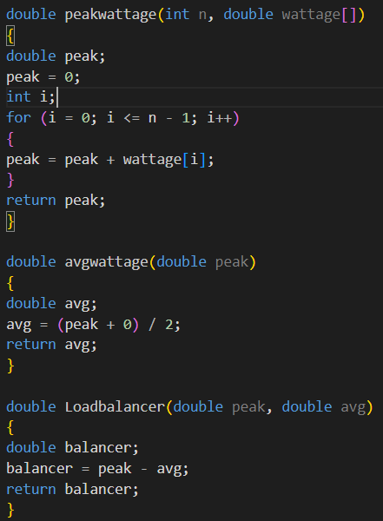
Wattage Calc:
This module will helps us to calculate the total wattage used by the devices and individual wattage used by the devices.
The concept of this modules is providing the wattage at which should be maintained to balance the loads for the appliances in the home.
In this module, the wattage of appliances are taken on the average values in the regular homes.
It was designed on the basis of peak wattage, average wattage (the minimum wattage will 0 watts assuming all are in off).
These are some functions which I used in calculating wattage..

Slide 17
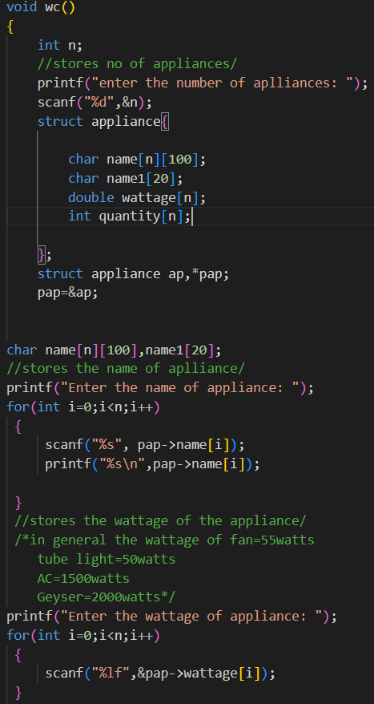
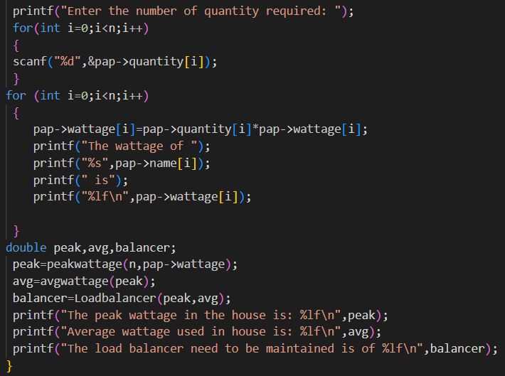
The code:
In this module, we initially 3 arrays of name, quantity and wattage .
Individually calculated the wattage of each appliance and the peak wattage and average wattage
Finally the Load balancer wattage, at which the load balancer must be maintained so that it can easily distribute the load to each appliances.
The minimum wattage at which load balancer is maintained is the average wattage of the appliances in the circuit
The maximum wattage of the load balancer is the peak wattage of the devices.
And finally at last we added the extra devices which are required in the home

Slide 18
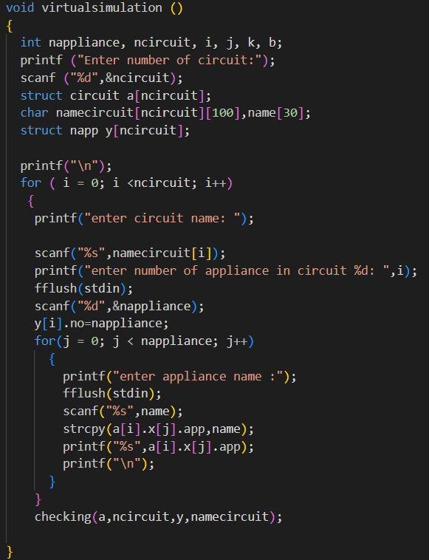
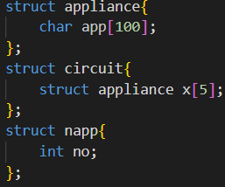
Virtual simulation
This module as the name suggests provides the user an user interface where it deals with the setting up of number of circuits an appliances in each circuit.
It also allows the user to add more appliances or circuits if needed.
For this module we used 3 structures called appliance, circuit and napp; here circuit is used to store the circuit names and in the circuit structure we used appliance structure for storing appliances[basically nested structure]
After setting up all the circuits we then call the function Checking where we pass structures….

Slide 19
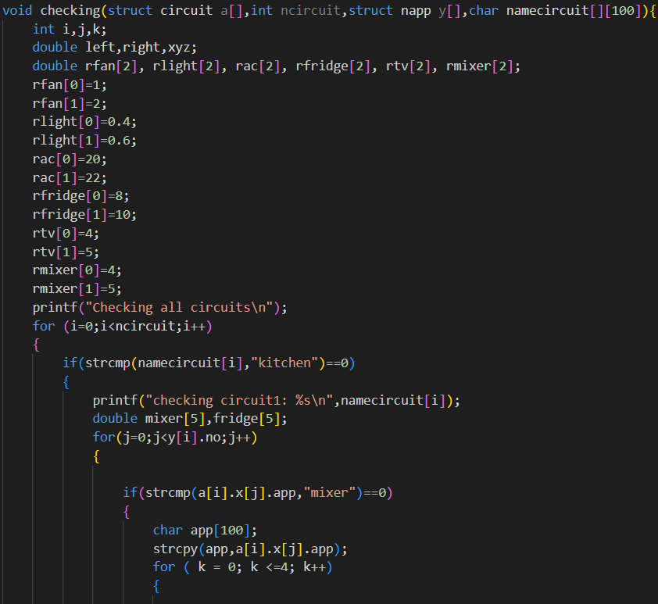
CHECKING
This module deals with monitoring each circuit and appliances parallelly
With the current each draws.
For instance in circuit 1 every appliances like mixer and fridge’s current
Values are monitored.
For mixer an int array named mixer will declared and then current value
Will be read for each index and every value will be passed to another
Implicit functions called switch breaker where through this every current
Reading is checked and if it is more or less than the specified range given
It performs an set of operation and try to minimize it.
After switch breaker checks the current and optimizes it then only it gets
Stored in mixer array.
After storing all current values in mixer array then a function neutral is
Called with the mixer array passed to it to check current returned to neutral.
So thorough these steps every appliances and circuit is checked with every
Current value optimized and stored safe.

Slide 20
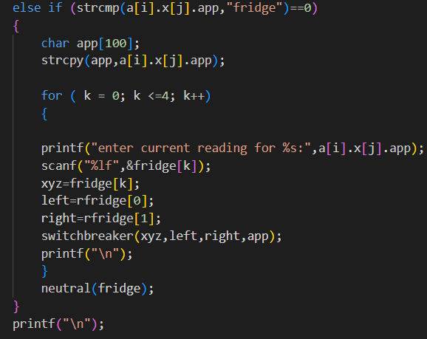
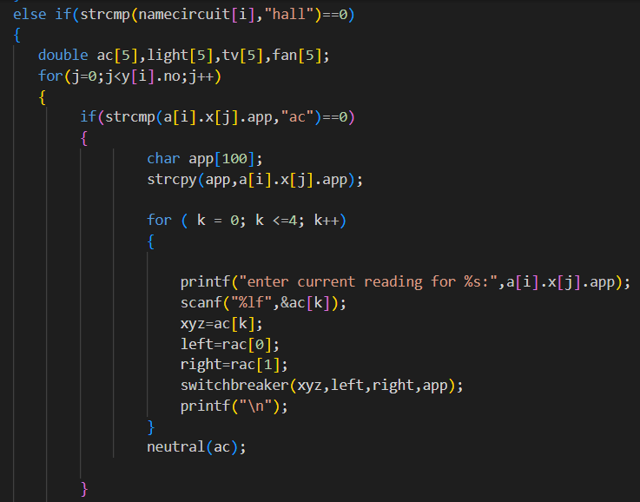
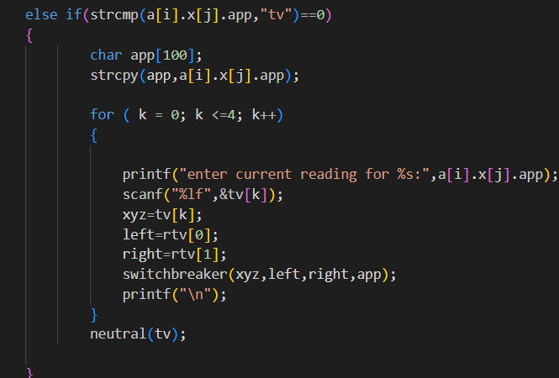
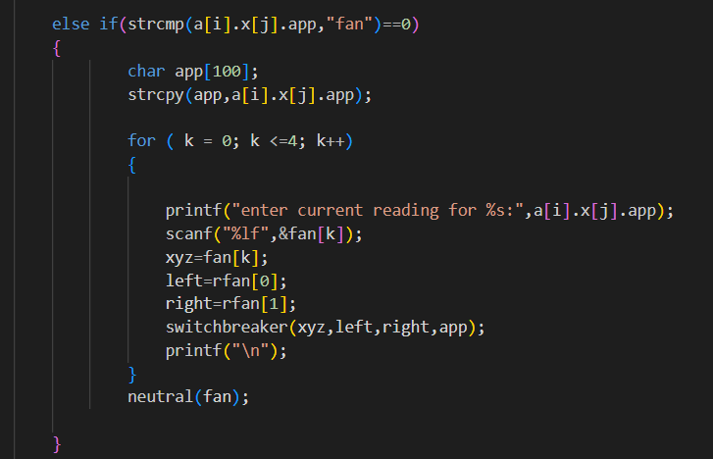
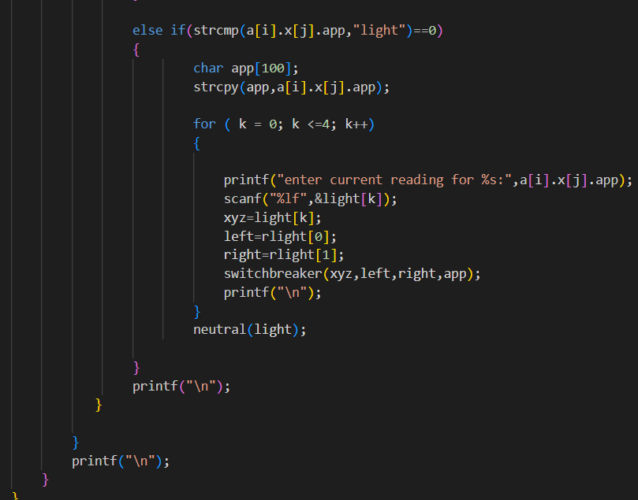

Slide 21
SWITCH BREAKER
Whenever a appliance use more power than the breaker is specified like 5-10A or 15-20A,20-30A the switch trips automatically if it exceeds the limit.
Single pole breakers which give 120V from one of the hot bus, these switches can be used for low voltage appliances
Double pole breakers in which 2 hotbus wires gets connected and collectively gives 240V which can be given to high voltage appliances.

Slide 22
Switch breaker
We created a module for switch breaker where it checks whether the current is sufficient or not for appliances.
If its getting more current than required then the switch breaker needs to be tripped and trips
And if current for appliances is just somewhat greater then it will go electric panel in which the current flow gets reduced.
Double pole is used for appliances which takes more voltage
Single pole is used for appliances which takes less voltage
We used char arrays to store the current values of the appliances
Here xyz is current flow of the appliance
In first if statement it checks whether the current is in optimal state
If the current flow is less than the appliance needed
Then it switch breaker trips If it is has more current reading then it goes electric panel

Slide 23
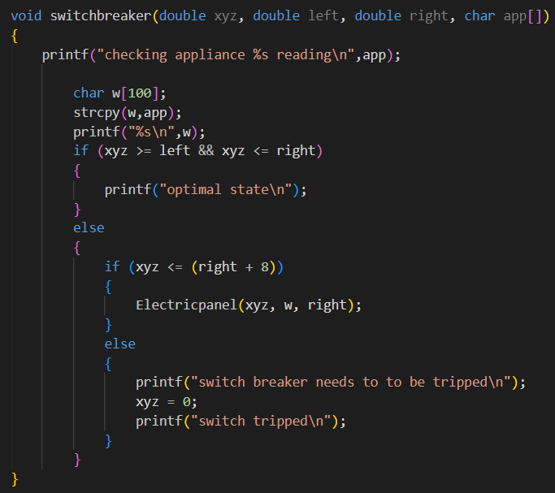
Code for switch breaker

Slide 24
ELECTRIC PANEL
We created a module called electric panel where current , xyz, right are parameters
Here xyz is current carried
This module checks every appliance and starts to decrease the current flowing to be in optimal state

Slide 25
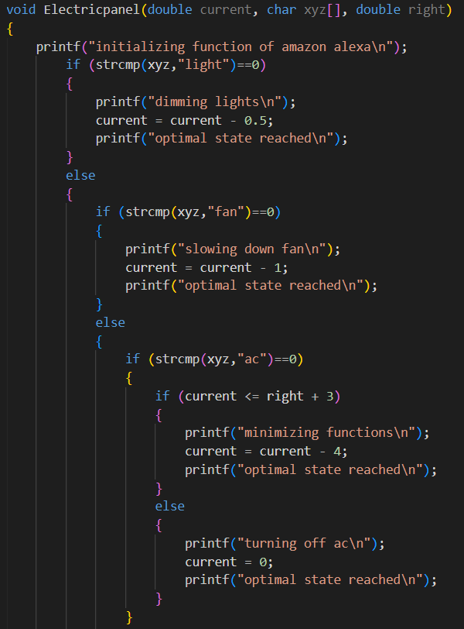
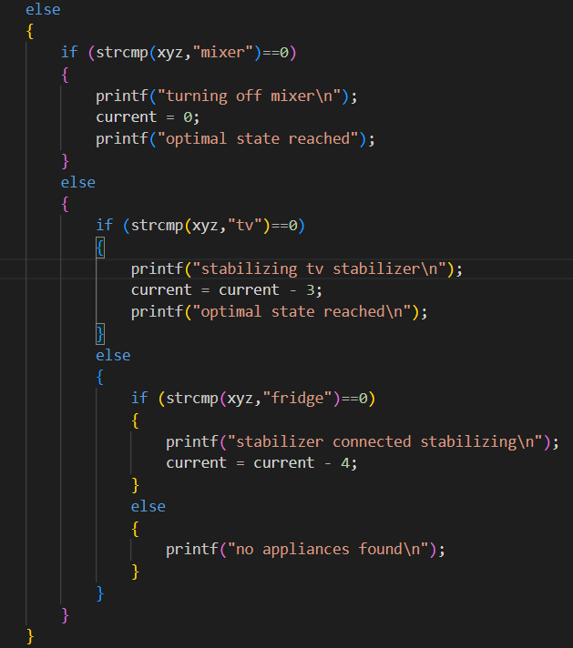
Electric panel code

Slide 26
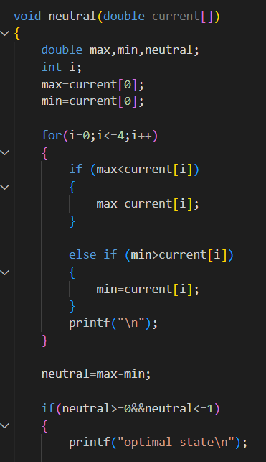
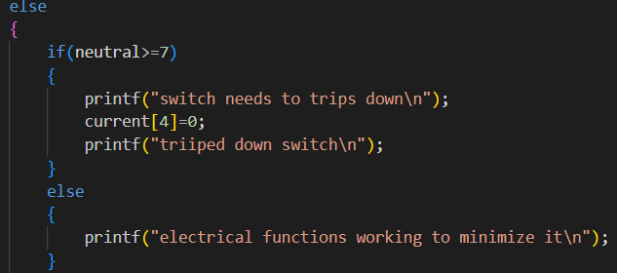
NEUTRAL
After optimizing all cuurents and gets stored in the appliance name int array it is passed to this module.
Where we find the max and min value of the array array using some steps.
Then we subtract Max and min current values and the value got is the current that is returned back to neutral wire.
If that value Is more than the specified range switch breaker is tripped and gets optimized
Or else electric panel function works again to minimize it.

Slide 27
Load balancer Demo
WHAT IS LOAD BALANCING
The main goal of a load balancer is to achieve perfect balance so that more total current can be supplied to each branch circuit.
To understand how balancing works, imagine that a circuit supplies a refrigerator that draws 8 amps; the other circuit supplies a chest freezer that draws 7 amps. Both appliances run all the time, year-round. To balance the load of the two circuits, the breakers should be on different hot bus bars, or "legs," of the service panel. That way, the amperage of the two circuits cancel each other out when the power returns to the utility on the neutral. In this case, the current on the neutral would be 1 amp: 8 – 7 = 1. If both appliances pulled 8 amps, the current on the neutral would be 0. The goal is to have the current on the neutral be as low as possible—for safety, energy-efficiency, and other reasons.​

Slide 28
How is it solved using programming?
The current values of the common household appliances are predefined.
Number of appliances in the household and its current state(on or off) is given as input by the user.
The appliances in the household are divided into branch circuits and the appliance which draws the highest and lowest current are calculated using if else if and else statements.
The current returned to the neutral in each circuit is calculated and given as output to the user.

Slide 29
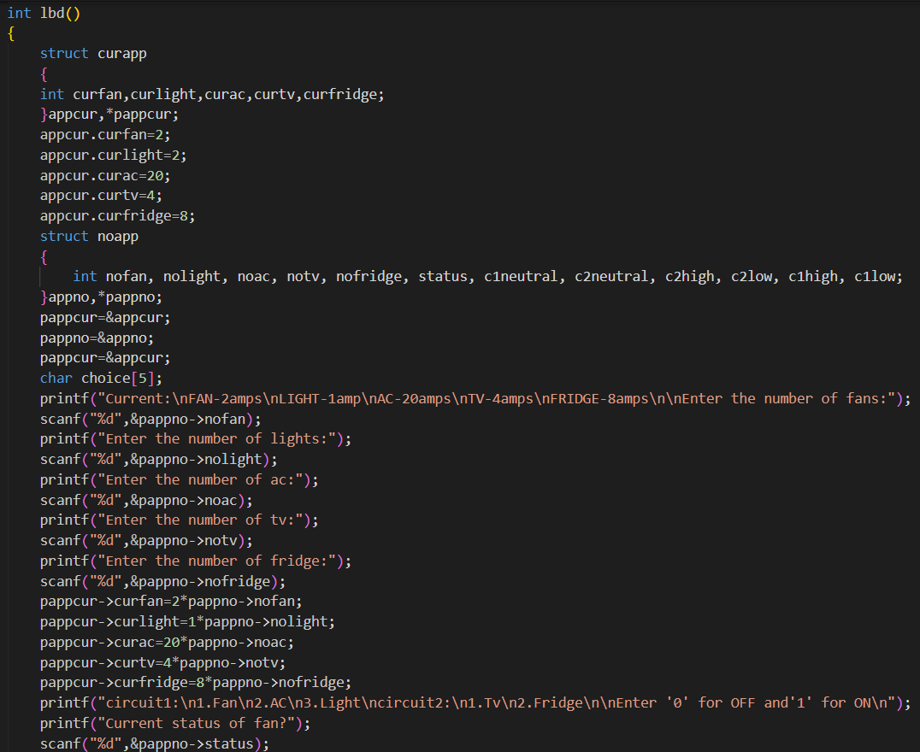
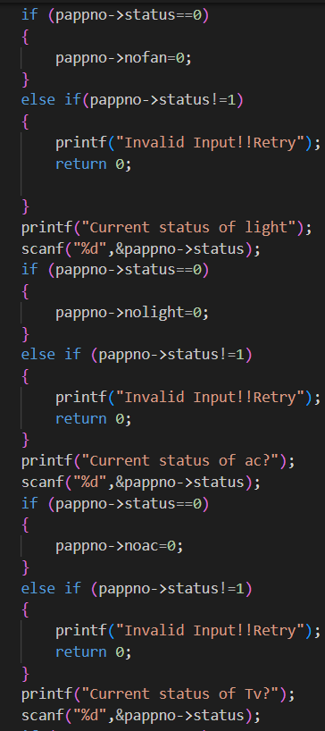
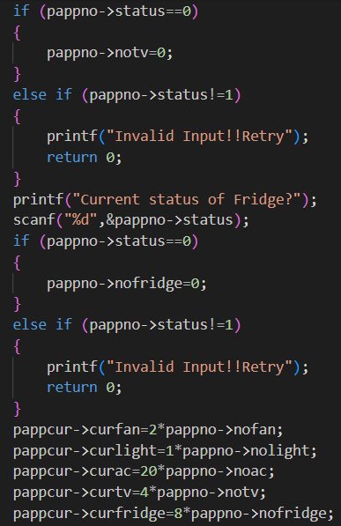
C code for Load balancer demo

Slide 30
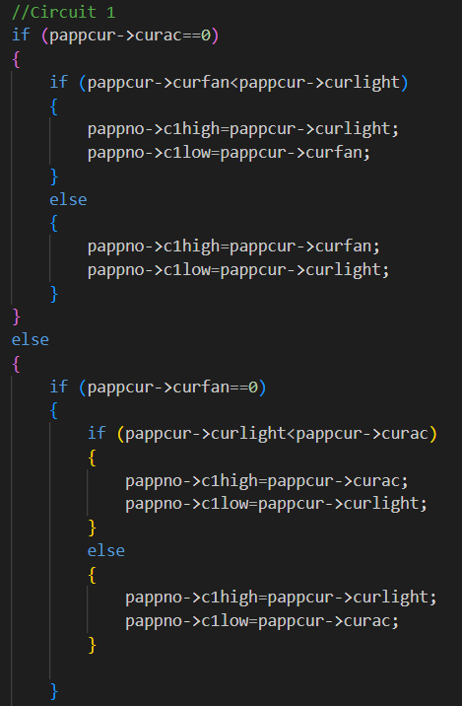
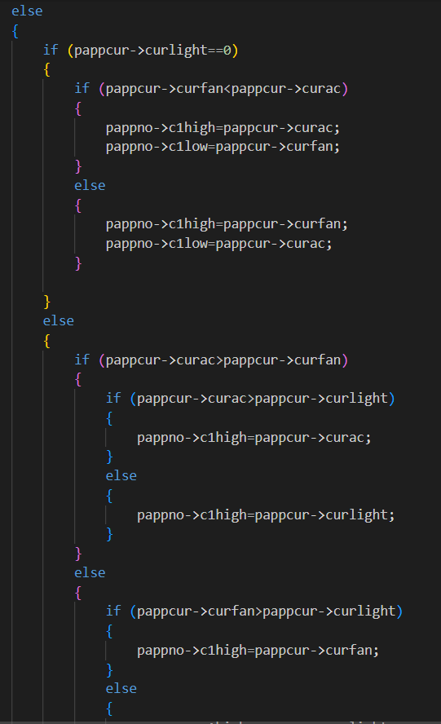
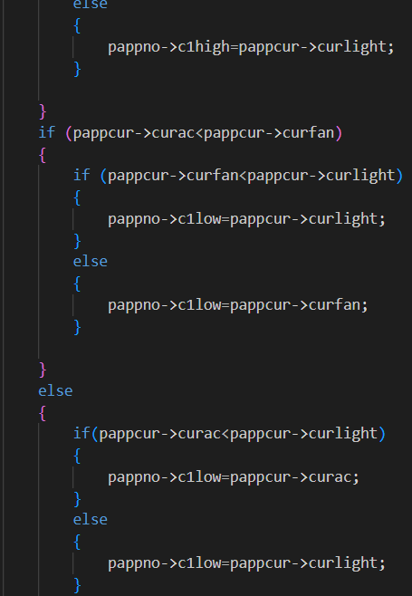
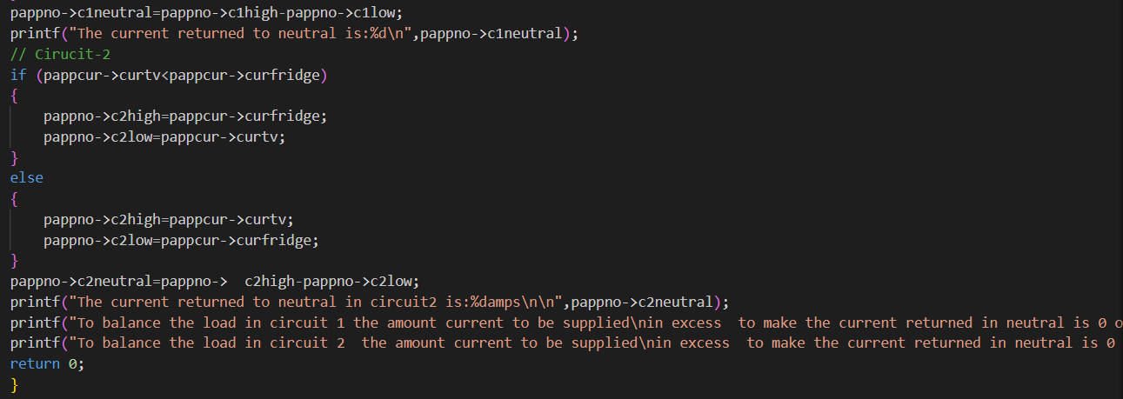
Calculating highest power drawing appliance in circuit 1 and 2

Slide 31

REFERENCES
www.thespruce.com
en.wikipedia.org
www.raritan.com

Slide 32

THANK YOU

